Slide 1
Lecture 10 2-3 Trees B Trees Exercises
Department of Computer Science
Hofstra University

Slide 2
B-tree I
Insert the following keys to a 3-way B-tree:
10, 20, 30, 40, 50, 60, 70, 80, 90

Slide 3
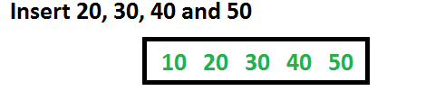
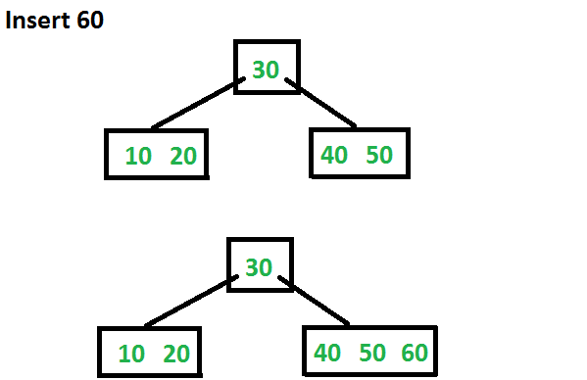
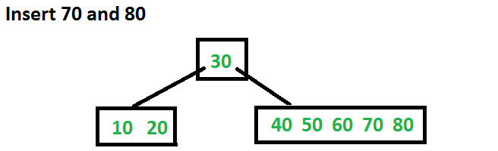
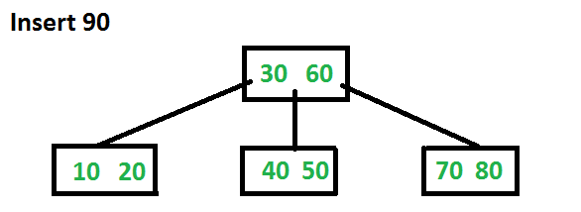

Slide 4
Exercise in Inserting a B-Tree
Insert the following keys to a 5-way B-tree:
3, 7, 9, 23, 45, 1, 5, 14, 25, 24, 13, 11, 8, 19, 4, 31, 35, 56

Slide 5
Exercise in Removal from a B-Tree
Given 5-way B-tree created by these data (last exercise):
3, 7, 9, 23, 45, 1, 5, 14, 25, 24, 13, 11, 8, 19, 4, 31, 35, 56
Add these further keys: 2, 6,12
Delete these keys: 4, 5, 7, 3, 14

